Slide 1
Use case diagram:
Search a recipe
client
Create a profile
Create recipe for the build in data
Schedule meals
Create recipe
Add ingredient
Edit recipes
Event
Daily, weekly, monthly, yearly
Delete client ingredients
Add ingredient for the build in data
Edit client recipes
Share recipe with another client
Edit ingredient
administrator
Cost information

Slide 2
Recipes
Edit
User interface guide:
Build in recipes
Add ingredient
Profile
Recipes
Ingredients
Schedule
Cart
Suggested recipes
List of user ingredient
User recipes
Schedule
Profile
Event
Edit profile
Daily schedule
Logout
Weekly schedule
Monthly schedule
Yearly schedule

Slide 3
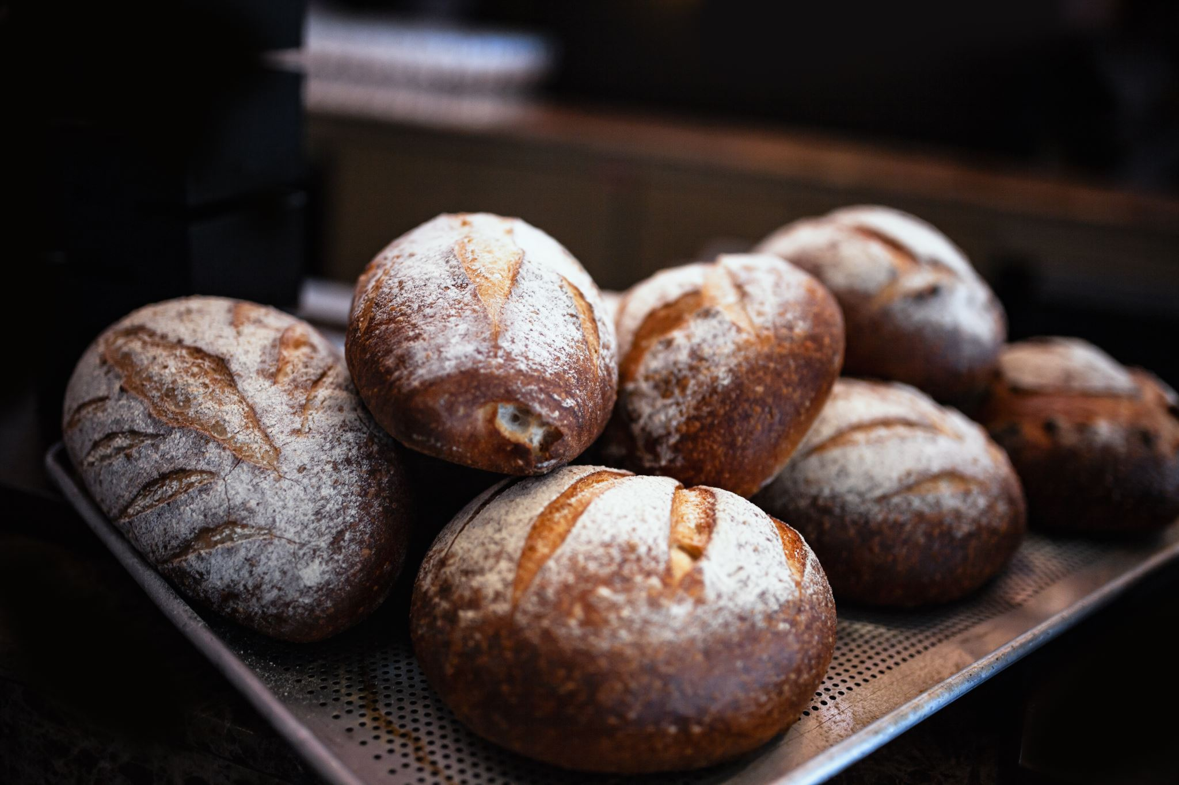


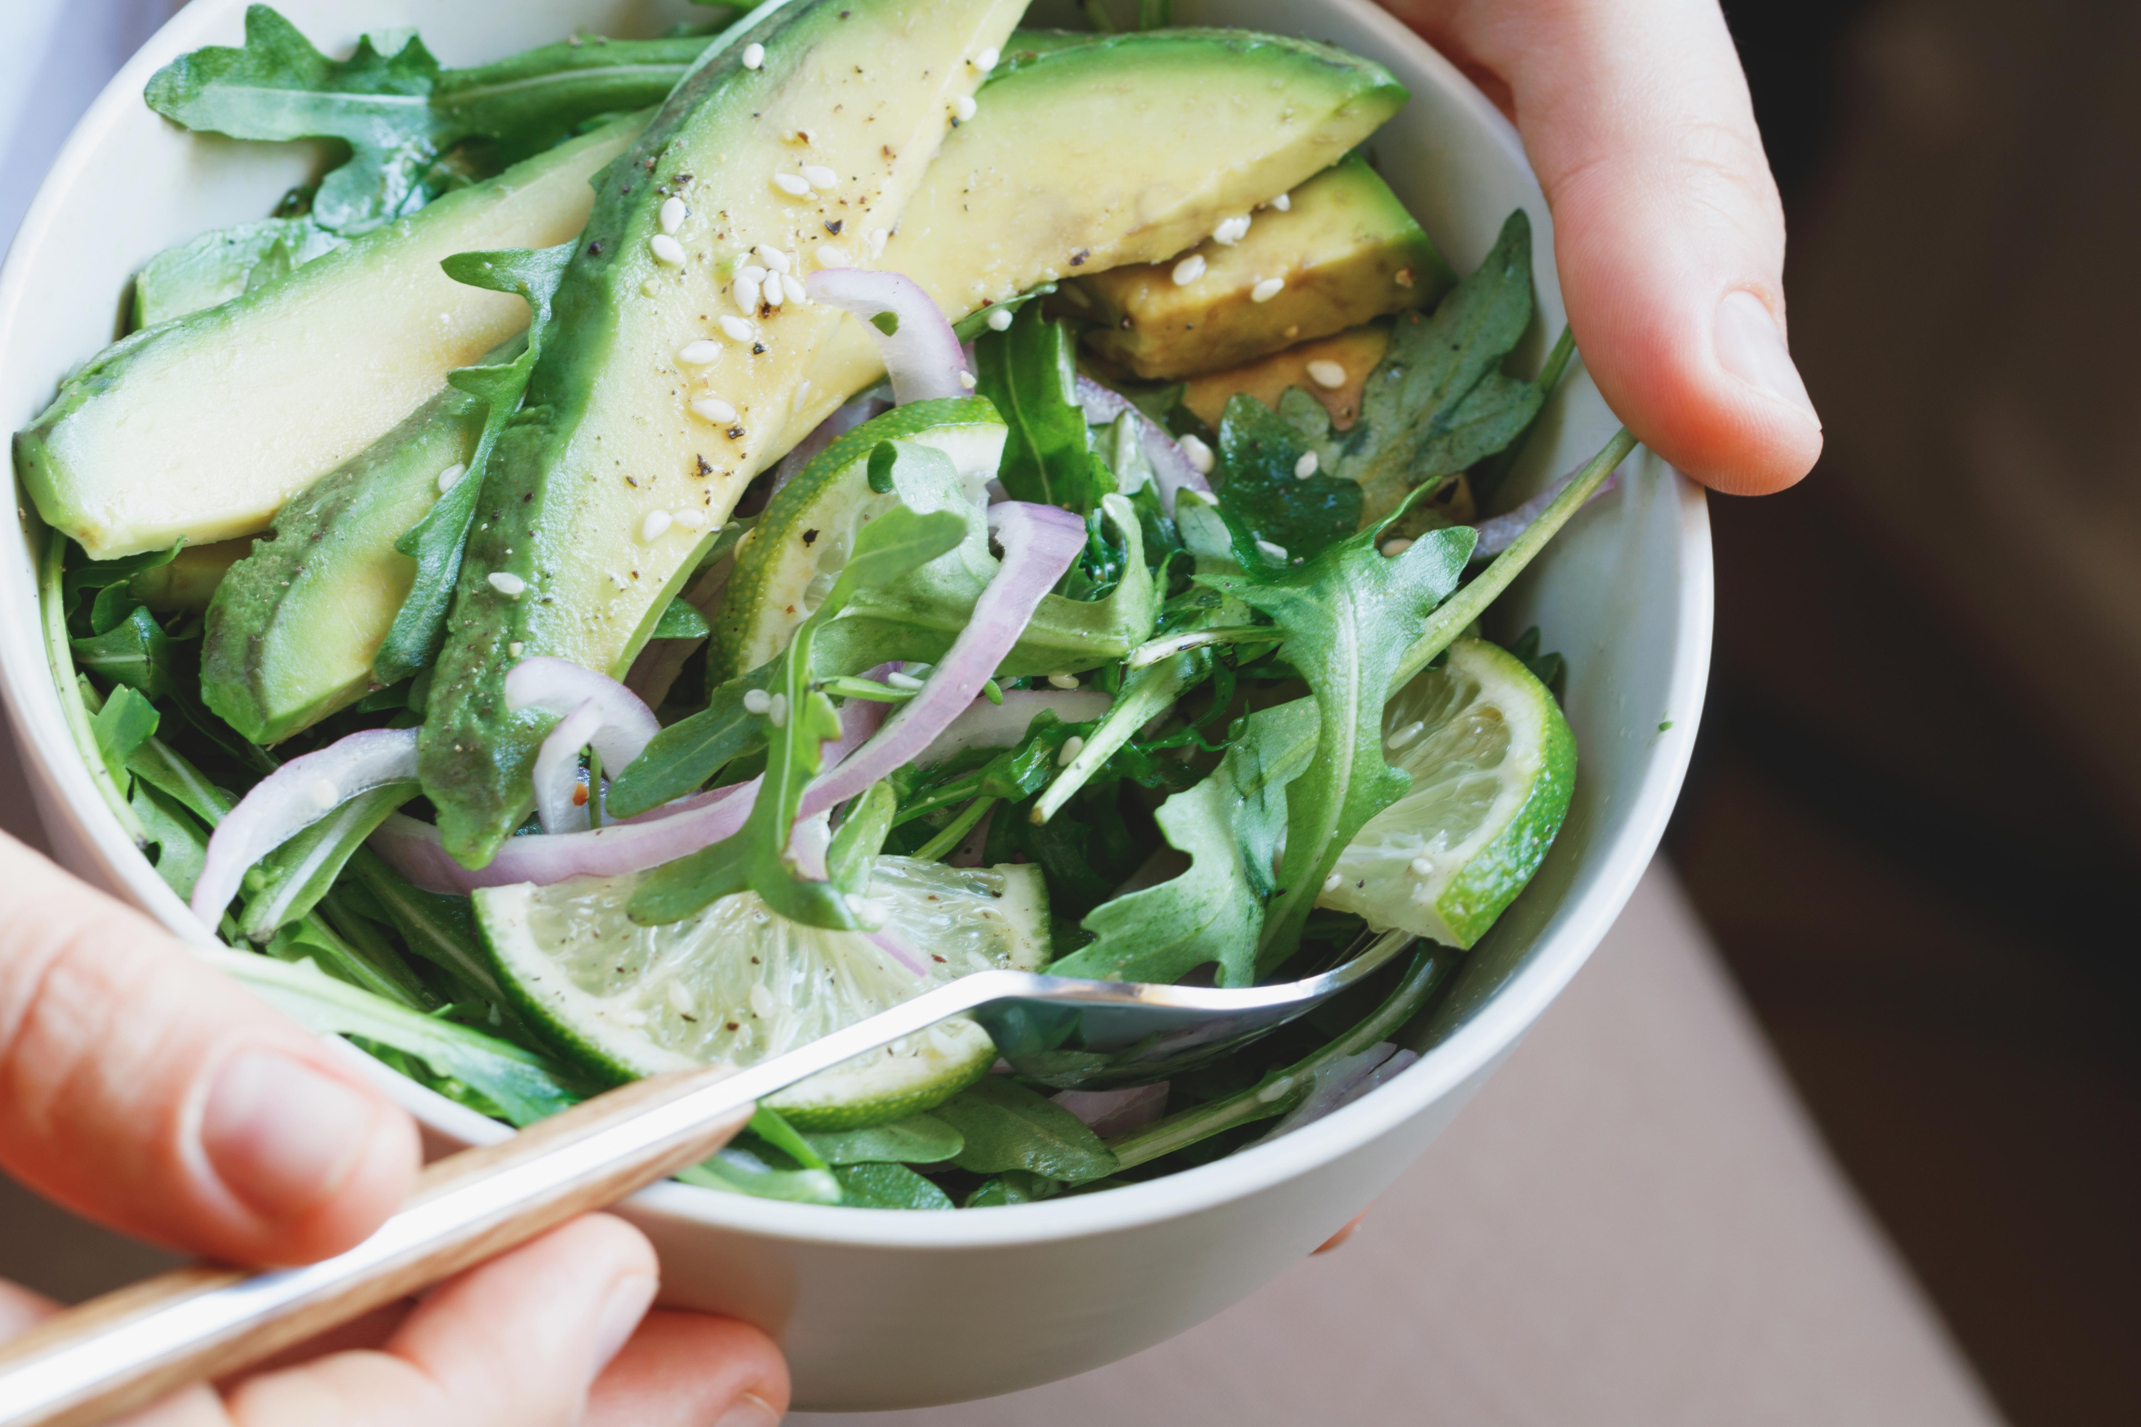

Profile
Recipes
Edit
Schedule
Cart
Profile
Recipes
Edit
Schedule
Cart
Filter
Filter
Build in recipes
Suggested recipes
Bread
Ingredients
Creator
info
Bread
Ingredients
Salamone sushi
Ingredients
Creator
info
Salamone sushi
Ingredients
Green salad
Ingredients
Creator
info
Green salad
Ingredients
Muffins
Ingredients
Creator
info
Muffins
Ingredients

Slide 4


Profile
Recipes
Edit
Schedule
Cart
Profile
Recipes
Edit
Schedule
Cart
Filter
Create a recipe
Create your recipe:
User recipes
Bread
Delete recipe
Name of the recipe :
Ingredients
Kosher
Salamone sushi
Delete recipe
Meat
Dairy
Parve
Mixed
Insert a picture
Ingredients
Insert instruction
Beef
Tofu
Milk
……..
……..
-Add an ingredient to the system
Green salad
Delete recipe
List the ingredients
Ingredients
Label to show the cost of the recipe
Muffins
Delete recipe
I would like to share my recipe
Ingredients
I would like to share my information
Save

Slide 5



Profile
Recipes
Edit
Schedule
Cart
Ingredients for : “Salamone sushi”
Parve
Nutritious value
Ingredients :
Total cost
Rice – 750 gram
The cost
Carrot – 150 gram
The cost
Salamone – 500 gram
The cost
Instruction :
*** Here will be presented how to make the dish step by step” ***

